Slide 1
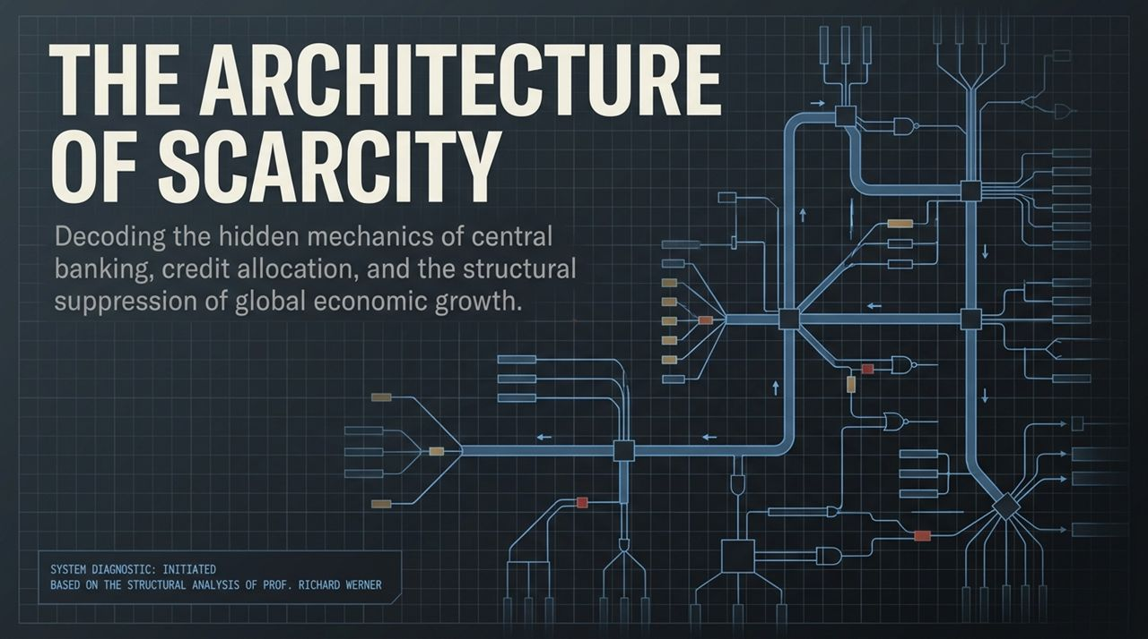
Notes:
Opening Statement & Core Thesis:
Welcome everyone. Today, we are opening a system diagnostic on the global financial architecture—specifically, how central banking, credit creation, and credit allocation intentionally suppress global economic growth.
Modern mainstream economics teaches us that economic stagnation, inflation, and recessions are natural, unavoidable cycles. We are going to dismantle that narrative today using empirical evidence and the structural analysis of Professor Richard Werner.
Key Talking Points:
The Premise: Prosperity and economic abundance are engineering choices. The scarcity, austerity, and zero-growth environment experienced across advanced economies today are not accidents or natural phenomena; they are structural outcomes produced by specific policy choices and monetary design.
System Diagnostic: We will examine how money is actually created, who controls its allocation, why our banking systems have consolidated into central planning engines, and how decentralized credit allocation can unlock sustained, non-inflationary 10%+ annual growth.
The Greatest Fraud In Human History | Prof. Richard Werner
https://www.youtube.com/watch?v=uVlx2en1RRc

Slide 2
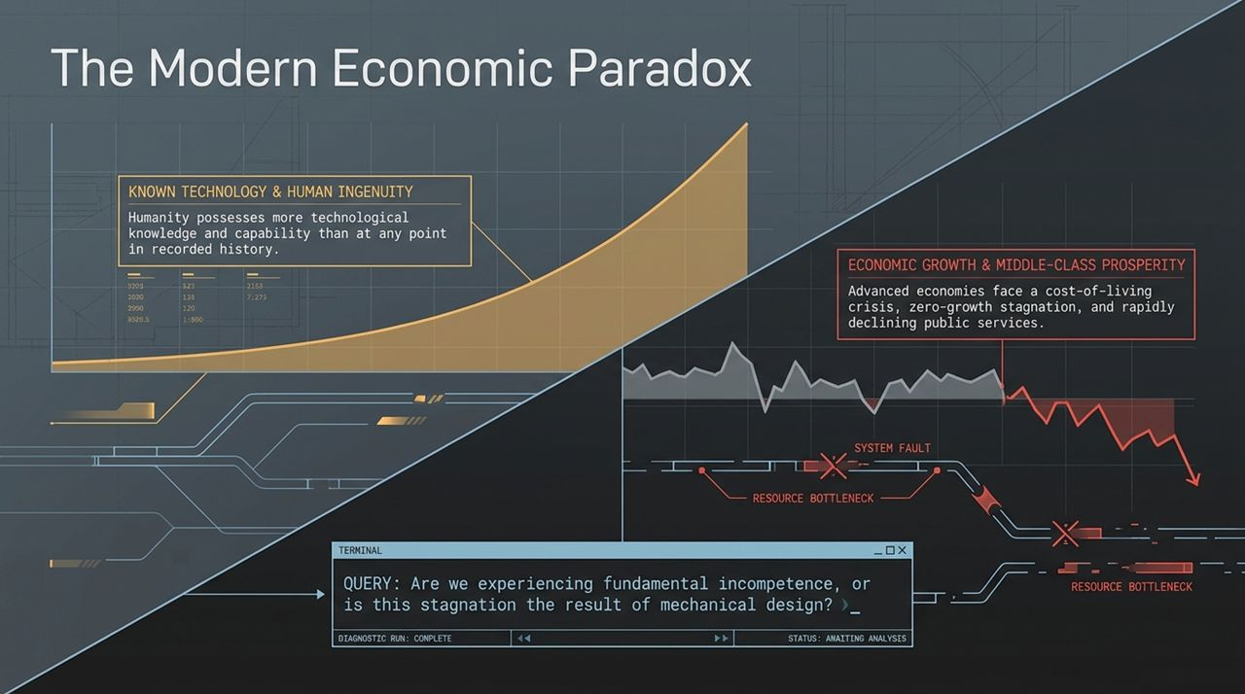
Notes:
Side A — Known Technology & Ingenuity: Humanity currently possesses more technological capability, scientific knowledge, and operational know-how than at any point in recorded history. Known technologies alone—without even factoring in classified or black-budget research—are sufficient to solve major production and productivity challenges.
Side B — Economic Reality: Despite this unprecedented technology, advanced economies face severe cost-of-living crises, zero-growth stagnation, declining public services, and eroding middle-class prosperity.
The Core Diagnostic Query: Are we witnessing widespread, fundamental incompetence across governments and central banks, or is this stagnation the result of mechanical design?
Takeaway: When outcomes consistently contradict available technological potential, we must look beyond surface excuses like bad luck or incompetence and inspect the mechanical constraints built into the system.

Slide 3
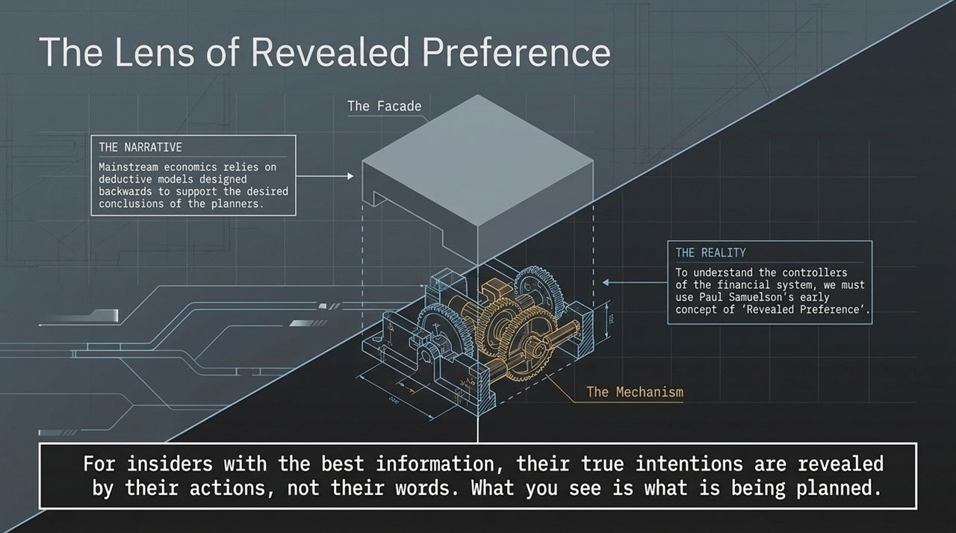
Notes:
The Narrative vs. Reality: Mainstream economic models operate backward. Theorists start with a desired policy conclusion, build a theoretical equilibrium model around it, and then invent convenient assumptions to justify the logic.
Revealed Preference: Samuelson argued that rational actors reveal their true intentions through their actions, not their words. For system insiders with the best information and tools, their true goals are revealed by the empirical outcomes they create.
Application to Central Banking: Central bankers frequently spin narratives about fighting inflation, supporting employment, or maintaining stability. However, by applying Revealed Preference, if their policies consistently result in banking consolidation, asset bubbles, and middle-class stagnation, we must conclude that these structural outcomes are precisely what is being planned.

Slide 4
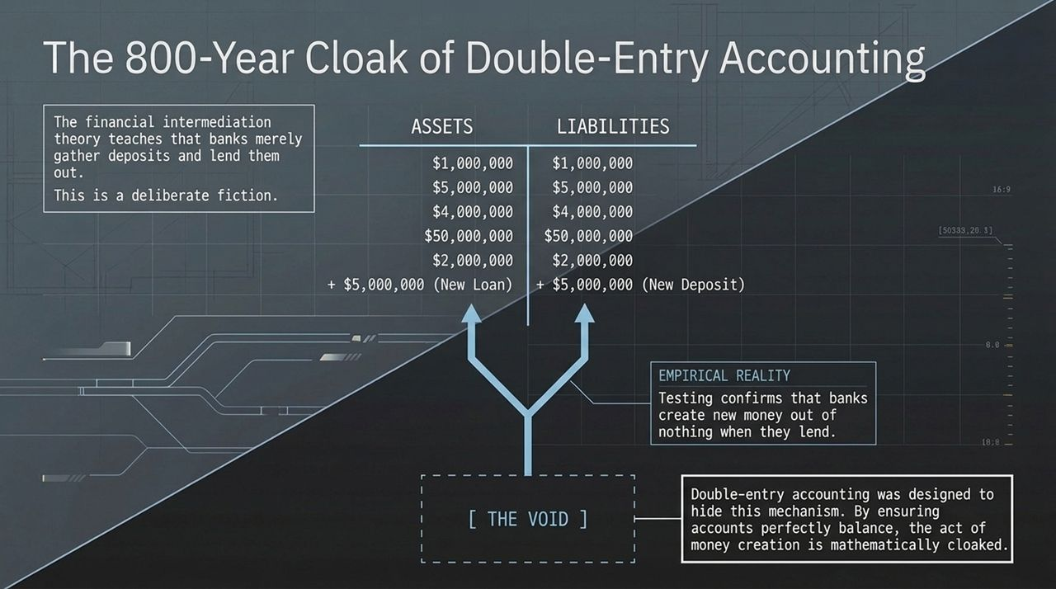
Notes:
The Financial Intermediation Lie: Mainstream textbooks teach that banks are merely intermediaries that collect deposits from savers and lend them out to borrowers. This theory claims banks cannot create money.
The Empirical Reality: Banks do not lend out pre-existing money. When a bank extends a loan, it simultaneously creates new money out of nothing by crediting the borrower’s deposit account.
The Accounting Cloak: Double-entry accounting, invented roughly 800 years ago, mathematically hides this creation. Because the bank registers the loan as an asset (the borrower’s promise to pay) and the new deposit as a liability, the balance sheet balances perfectly. To an outside observer, it looks as if pre-existing money was simply transferred, hiding the act of new money creation in plain sight.

Slide 5
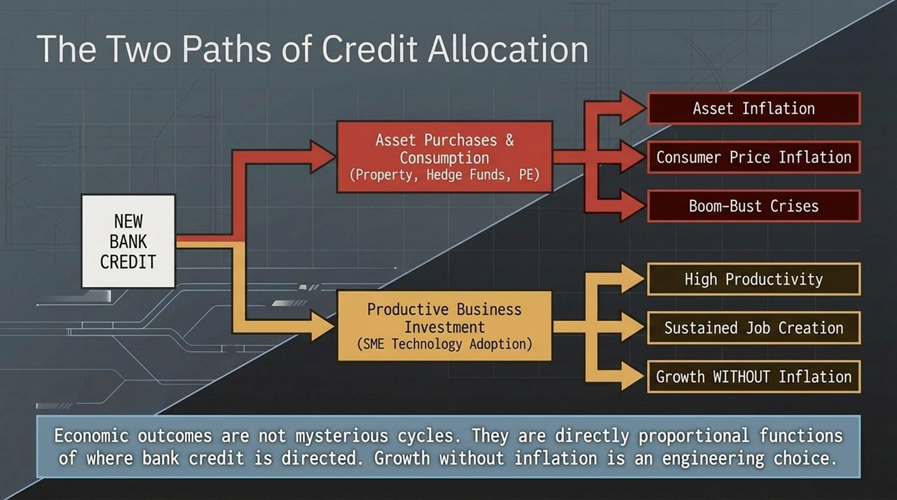
Notes:
Path 1 — Asset Purchases & Consumption (Non-Productive):
When new bank credit is funneled into asset purchases (real estate, private equity, hedge funds, financial speculation) or pure consumption, no new goods or services are produced.
Outcome: Asset price inflation, consumer price inflation, wealth inequality, and destructive boom-bust financial crises.
Path 2 — Productive Business Investment:
When new bank credit is directed toward productive business investment—specifically enabling small and medium enterprises (SMEs) to adopt new technology and expand production—the supply of goods and services grows alongside the money supply.
Outcome: High productivity, sustainable job growth, rising real wages, and growth WITHOUT inflation.
Conclusion: Economic outcomes are direct functions of credit direction. Managing growth is an engineering choice.

Slide 6
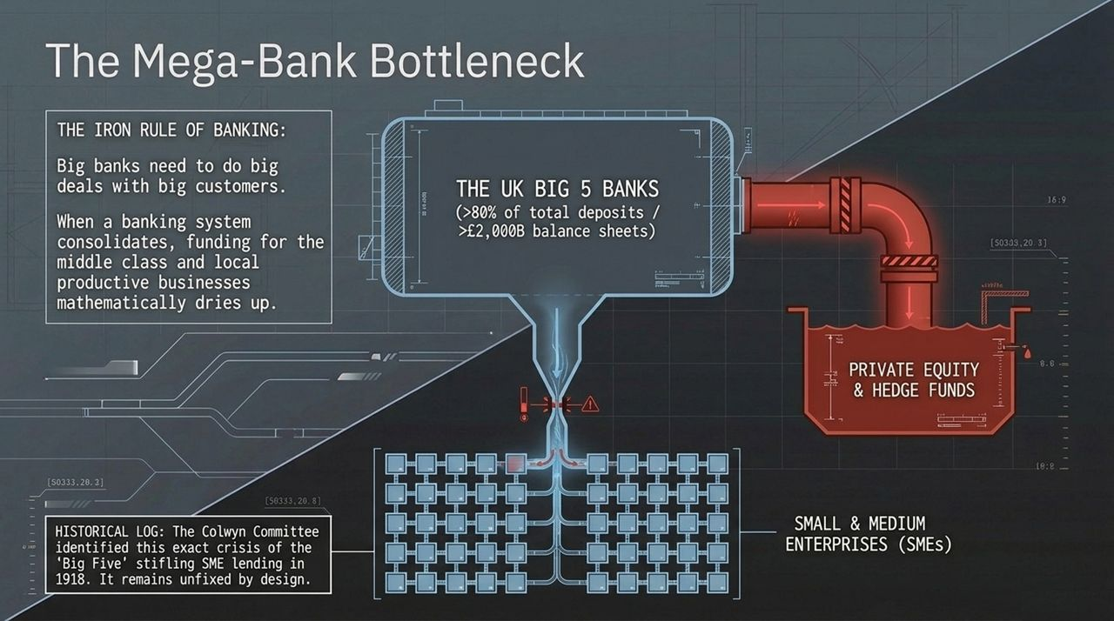
Notes:
The Iron Rule of Banking: Large banks inherently require large deal sizes to justify their overhead and corporate structure. Big banks want to do big deals with big customers (e.g., multinational corporations, private equity, hedge funds).
The SME Funding Desert: As a banking sector consolidates into a few mega-institutions, credit for local businesses, middle-class entrepreneurs, and SMEs mathematically dries up. Large banks simply refuse to evaluate or service small $100k–$1M productive business loans.
Historical Proof (Colwyn Committee 1918): Over a century ago, the UK Parliamentary Colwyn Committee identified that the consolidation of the Big Five banks was starving SMEs of credit and ruining industrial productivity. Over 100 years later, this known failure remains unaddressed because central consolidation serves the interests of central planners.

Slide 7
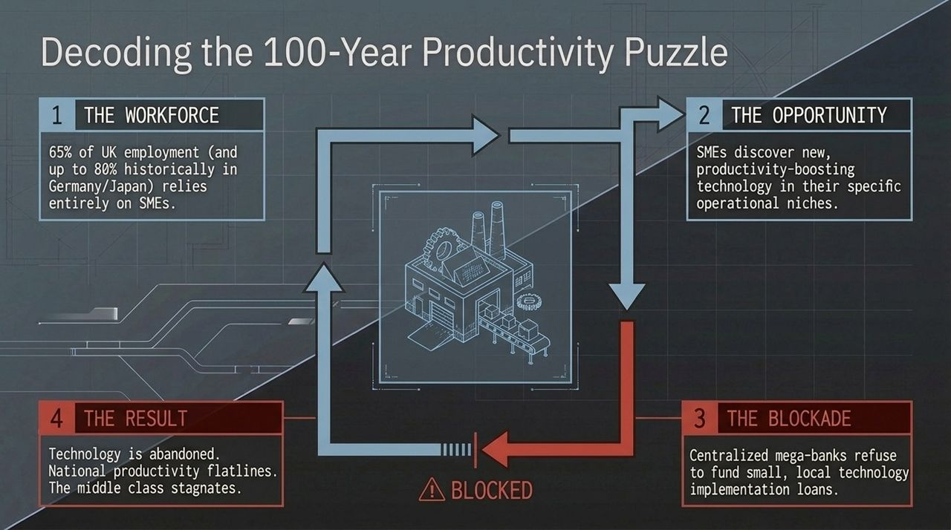
Notes:
The Iron Rule of Banking: Large banks inherently require large deal sizes to justify their overhead and corporate structure. Big banks want to do big deals with big customers (e.g., multinational corporations, private equity, hedge funds).
The SME Funding Desert: As a banking sector consolidates into a few mega-institutions, credit for local businesses, middle-class entrepreneurs, and SMEs mathematically dries up. Large banks simply refuse to evaluate or service small $100k–$1M productive business loans.
Historical Proof (Colwyn Committee 1918): Over a century ago, the UK Parliamentary Colwyn Committee identified that the consolidation of the Big Five banks was starving SMEs of credit and ruining industrial productivity. Over 100 years later, this known failure remains unaddressed because central consolidation serves the interests of central planners.

Slide 8
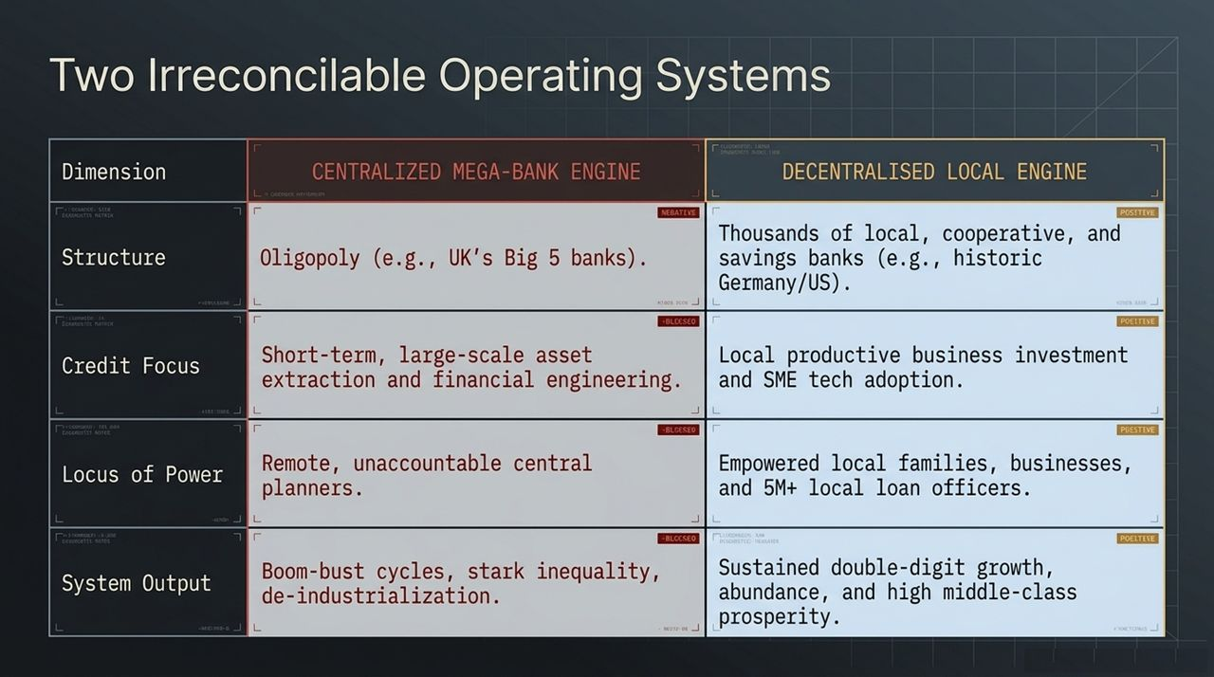
Notes:
Structure: Centralized systems rely on a small oligopoly of giant banks (e.g., UK's Big 5). Decentralized systems rely on hundreds or thousands of independent, local cooperative and savings banks (e.g., historic Germany, US community banks).
Credit Focus: Centralized engines prioritize large-scale financial engineering, private equity buyouts, and property speculation. Decentralized engines prioritize local productive investment and SME technology adoption.
Locus of Power: Centralized systems place power in the hands of remote, unaccountable central bankers. Decentralized systems empower millions of local loan officers and community boards who actually know their local businesses.
System Output: Centralized engines yield boom-bust cycles, de-industrialization, and extreme inequality. Decentralized engines yield double-digit growth, economic resilience, and widespread prosperity.

Slide 9
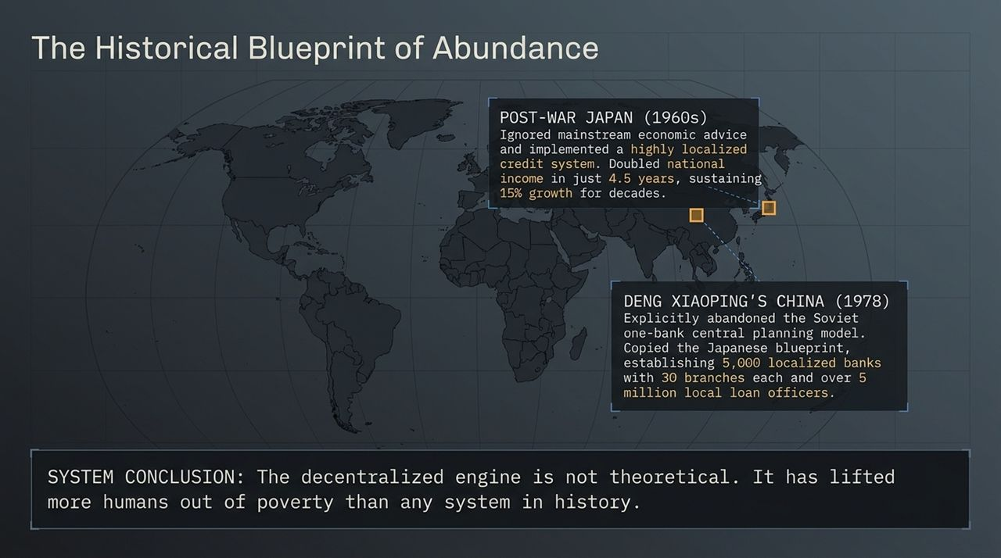
Notes:
Post-War Japan (1960s): Prime Minister Ikeda announced a plan to double national income in 10 years. Mainstream economists mocked it as impossible. By utilizing a localized credit allocation system directed toward productive investment, Japan doubled its national income in just 4.5 years and sustained ~15% growth for decades.
Deng Xiaoping’s China (1978): When Deng Xiaoping sought to modernize China, he visited Japan to learn their secret. China explicitly abandoned the Soviet single-bank central planning model. They established over 5,000 localized banks with tens of thousands of branches and over 5 million local loan officers.
Conclusion: This decentralized credit creation engine powered the greatest reduction in poverty in human history. Rapid economic growth is not theoretical—it has been proven repeatedly.

Slide 10
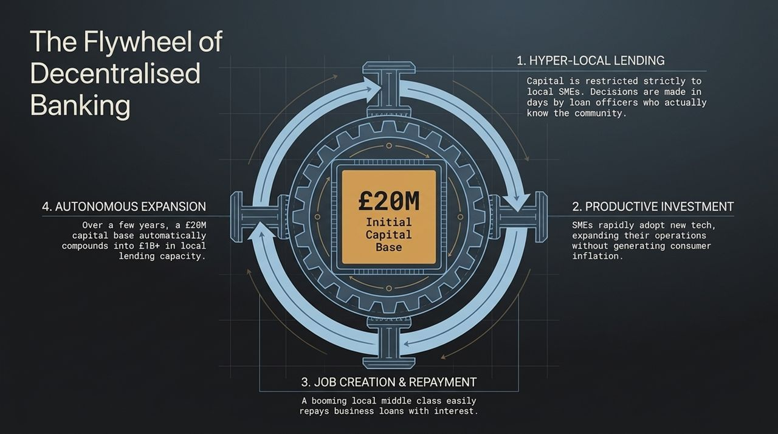
Notes:
Step 1 — Hyper-Local Lending: Capital is strictly restricted to local businesses. Decisions are made within days by local loan officers who personally evaluate the business owner and community need.
Step 2 — Productive Investment: Local SMEs use the loans to acquire equipment, software, and technology, increasing productivity and output without generating inflation.
Step 3 — Job Creation & Repayment: Enhanced business profitability creates high-paying local jobs. Borrowers easily service and repay their loans with interest out of real cash flows.
Step 4 — Autonomous Expansion: As loans are repaid, the bank’s capital compounds. Over a few years, an initial £20M capital base automatically scales to support over £1B in local lending capacity, creating a self-sustaining local growth engine.

Slide 11
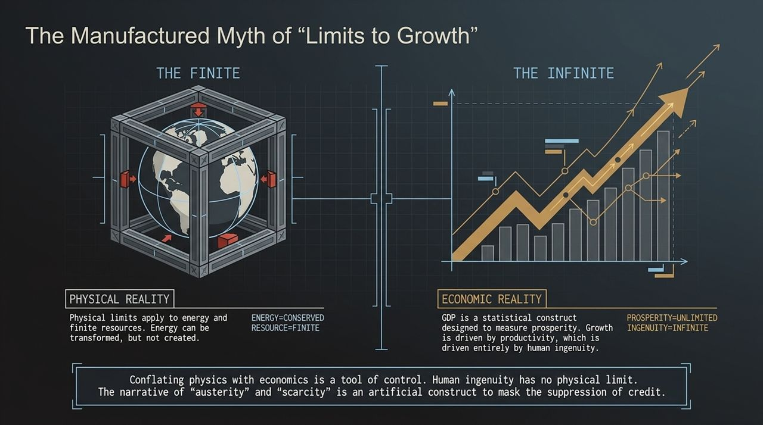
Notes:
Conflating Physics and Economics: Central planners deliberately conflate physical resource limits with economic growth to justify artificial austerity.
Physical Reality (Physics): In physics, energy is conserved and finite resources are transformed, not created. Physical laws govern matter and energy.
Economic Reality (GDP & Value): GDP is not a measure of physical mass or resource depletion; it is a statistical construct measuring value, utility, and prosperity. Economic growth is driven by productivity, which is driven by technology and human ingenuity.
The True Boundary: There is no physical law limiting human ingenuity. Framing scarcity as an inevitable physical boundary is a narrative designed to make populations accept managed decline and central control.

Slide 12
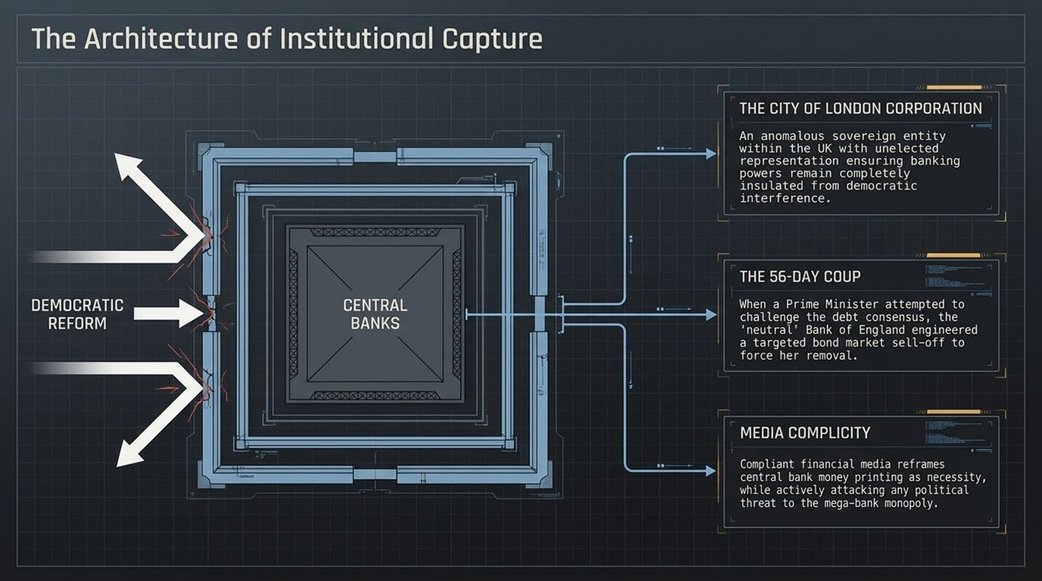
Notes:
The City of London Corporation: An anomalous, sovereign institutional enclave within the UK. With unelected political representation (e.g., the Remembrancer in Parliament), it ensures financial institutions remain insulated from democratic reform.
The 56-Day Coup (Liz Truss Example): When Prime Minister Liz Truss attempted to challenge the central bank consensus and push for rapid growth, the Bank of England engineered a targeted bond market sell-off. By destabilizing gilt yields, they forced her removal and restored financial orthodoxy.
Media Complicity: Compliant financial media outlets frame central bank interventions as technical necessities while attacking any political figure who threatens the mega-bank monopoly.

Slide 13
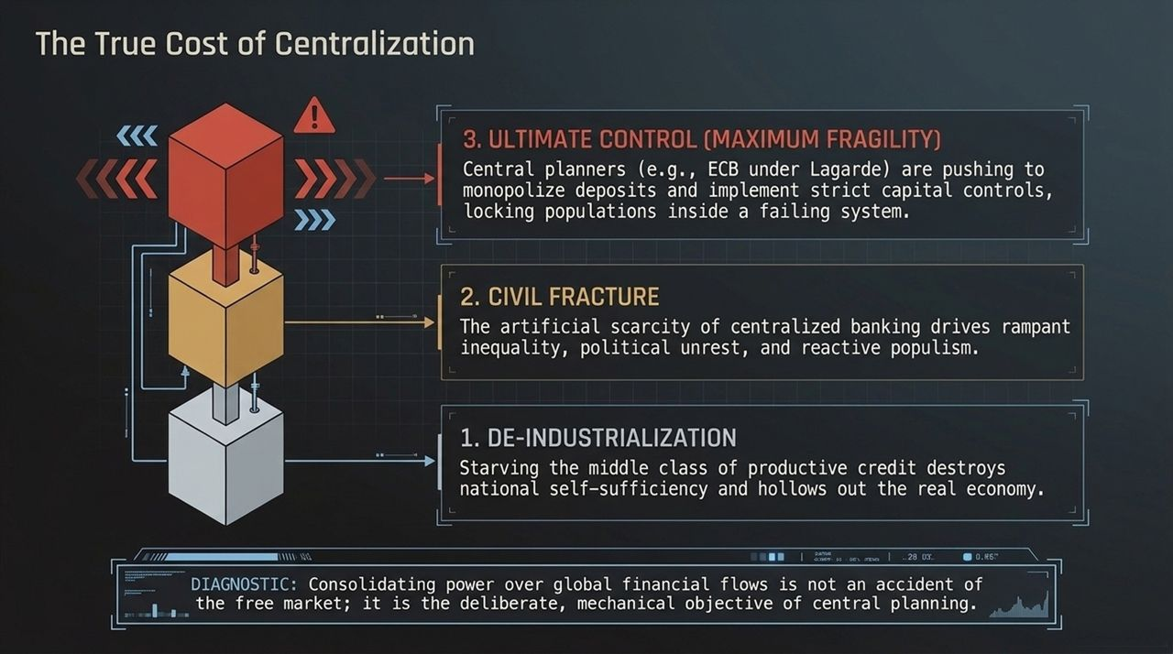
Notes:
1. De-Industrialization: Denying productive credit to domestic SMEs hollows out the real manufacturing base, destroying national self-sufficiency and middle-class employment.
2. Civil Fracture: Artificial credit scarcity creates rampant wealth inequality, collapsing public services, and political instability.
3. Ultimate Control (Maximum Fragility): Centralized entities (e.g., the ECB under Lagarde) are actively attempting to centralize deposit accounts and enforce capital controls. Restrictions on non-EU bank deposits and moves toward Central Bank Digital Currencies (CBDCs) aim to lock citizens inside a failing, centrally planned system.

Slide 14
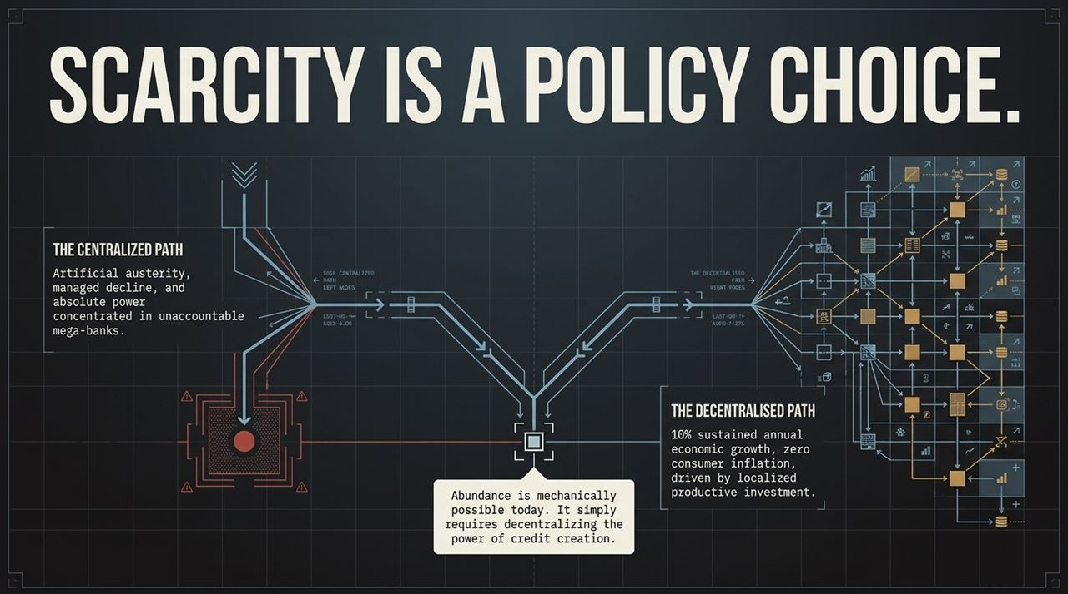
Notes:
Path A — The Centralized Path:
Managed economic decline, artificial austerity, zero-growth stagnation, asset bubbles, and total power concentrated in unelected central planners.
Path B — The Decentralized Path:
Sustainable double-digit annual economic growth, zero consumer inflation, rapid technology adoption, empowered local communities, and broad middle-class abundance.
Diagnostic Conclusion: Scarcity is not an environmental or technological inevitability—it is a policy choice. Abundance is mechanically achievable today by decentralizing credit creation.

Slide 15
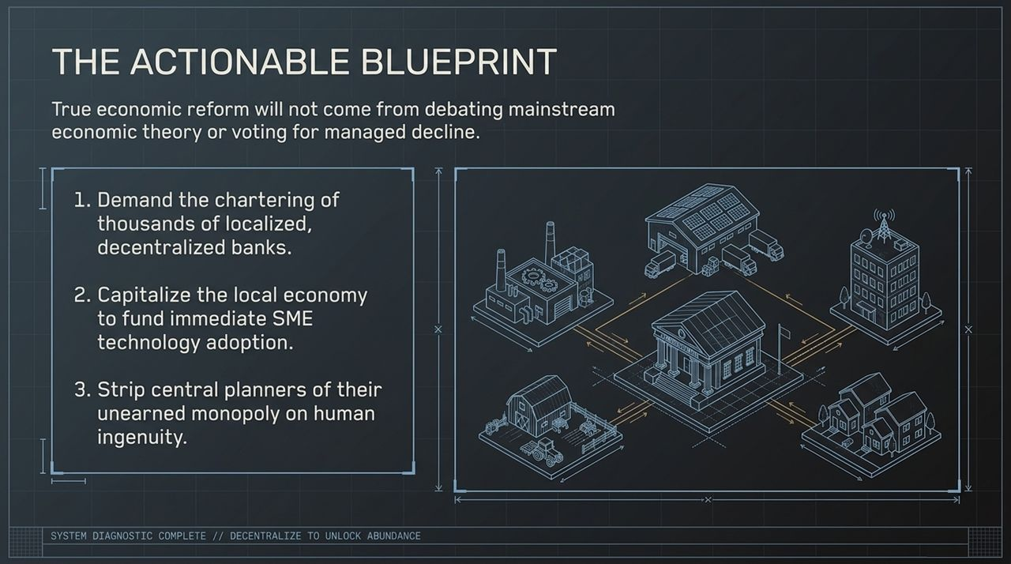
Notes:
1. Charter Thousands of Local Banks: Demand legislative and regulatory reform to easily charter thousands of independent, community-focused local banks.
2. Capitalize Local SME Growth: Provide the necessary initial capital base to local banks to fund immediate technology adoption for domestic SMEs.
3. Strip Central Planners of Monopolies: Remove the central banking monopoly over credit allocation and restore democratic, localized economic decision-making.
System Diagnostic Status: COMPLETE. Decentralize to unlock abundance.

Slide 16
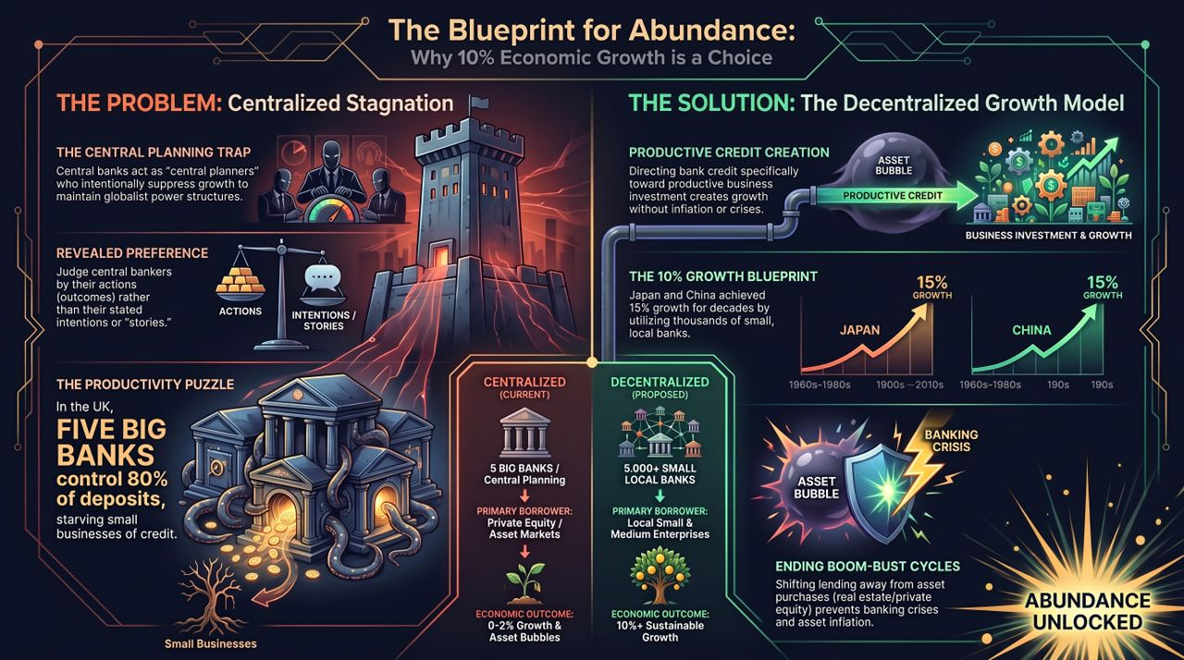
Notes:
The Trap: Central planning keeps us trapped in 0–2% growth, asset bubbles, and recurring banking crises by funneling credit to private equity and asset speculation.
The Mechanism: Revealed preference shows us that central planners maintain this trap for power and control.
The Solution: Establishing 5,000+ local banks shifts primary borrowing to local SMEs, driving productive business investment.
The Vision: This shift permanently eliminates boom-bust cycles and unlocks 10%+ sustainable annual economic growth. Prosperity is a structural choice—let's demand the right architecture.
The Greatest Fraud In Human History | Prof. Richard Werner
https://www.youtube.com/watch?v=uVlx2en1RRc

